Slide 1


Evaluating Continual Learning strategies for audio classification
FACOLTÀ DI INGEGNERIA DELL’INFORMAZIONE, INFORMATICA E STATISTICA
Master Degree in Data Science
Thesis Defense
Candidate:
Alessandro Taglieri, 1890945
Thesis Advisor:
Prof. Simone Scardapane
Academic Year:
2020/2021

Slide 2
Agenda
Motivations and current state of the art
Properties of Continual Learning
CL benchmark on ESC-50 dataset
CL strategies on audio classification
Metrics results
Contributions and future works

Slide 3
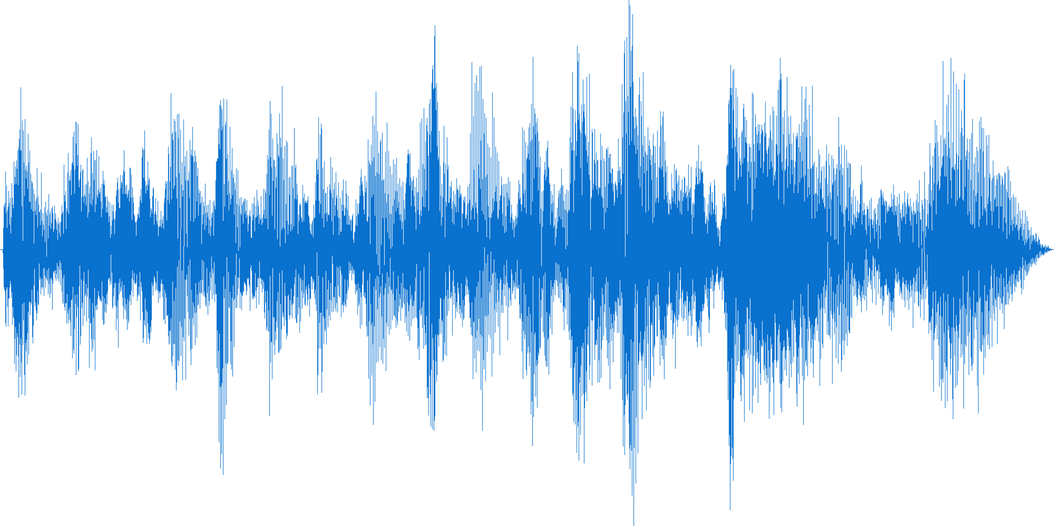
Motivations and current state of the art
From Deep Learning to Continual Learning:
Strictly dependence on the quality of the data
Learning from a continuous stream of data that may change through time
Avoiding Catastrophic Forgetting problem
Why Audio classification?
Unexplored data type in the context of Continual Learning
Audio data easily changes over time
Starting point to make contributions to Avalanche project
Fig1: Example of audio waveform

Slide 4
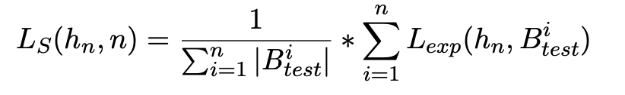
Properties of Continual Learning
A continual learning algorithm A^{CL} is an algorithm with the following signature:
Task: It is a learning experience characterized by a unique task label t and its target function. Different scenarios of continual learning framework depends on how the concept of task is treated:
h_{i} is the current hypothesis at timestamp i;
M_{i} is an external memory where we can save previous training examples;
t_{i} is a task label;
B_{i} is the training batch of examples.
Single incremental task (SIT);
Multi task;
Multi incremental task.
The objective of a CL algorithm is to minimize the loss L_{S} over the entire stream of data L_{S}
. . .
e₀
e₁
e₂
Experiences
Time

Slide 5




Exepriments set up
CL BENCHMARKS ON ESC-50 DATASET
EVALUATING
CL METRICS
CONCLUSIONS & F FUTURE WORKS
PERFORM CL STRATEGIES
Creation of two type of benchmarks based on two CL scenarios:
Multi task incremental;
Domain incremental
Performing three different CL strategies on benchmarks previously created:
Replay;
Naive;
EWC (Elastic Wight Consolidation)
Strategies evaluation on different CL metrics with five different executions:
Accuracy;
Loss;
Forgetting;
BWT (Backward Transfer);
System metrics
Contributions, considerations and possible future works:
Testing more CL strategies;
New benchmark on different data;
More contributions in Avalanche

Slide 6
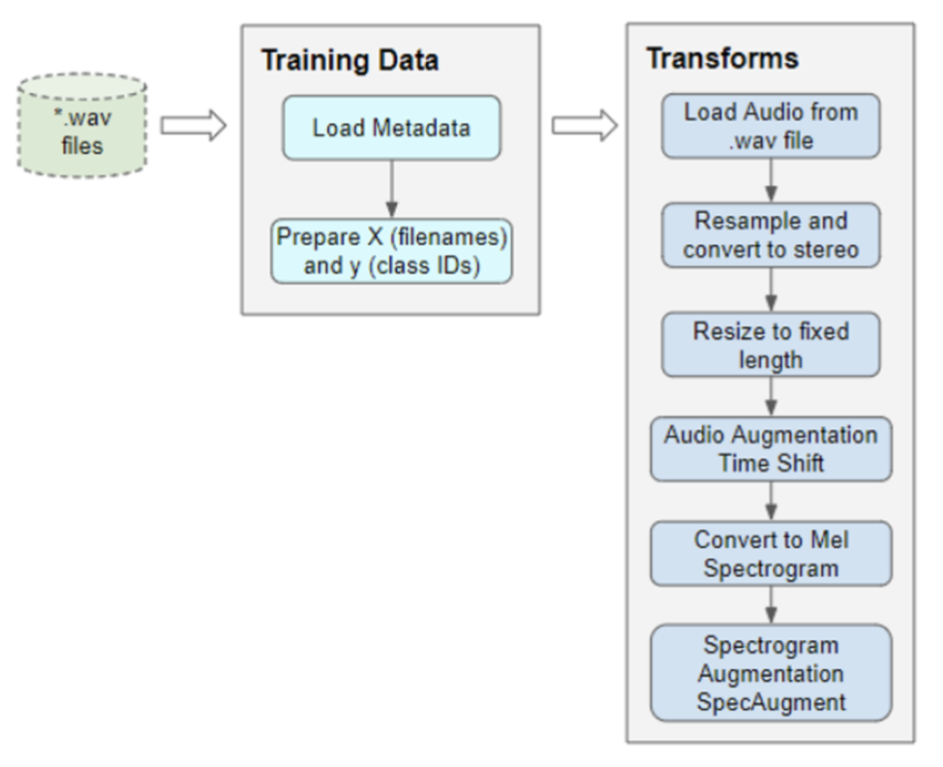
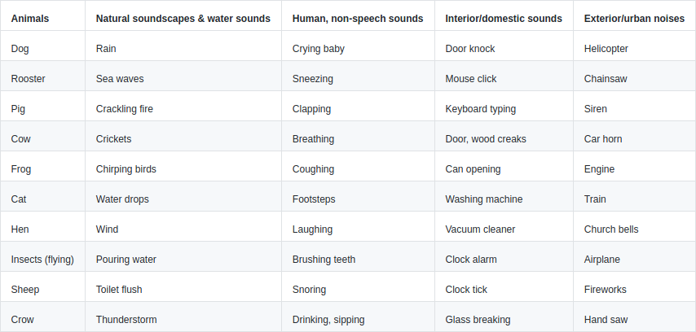
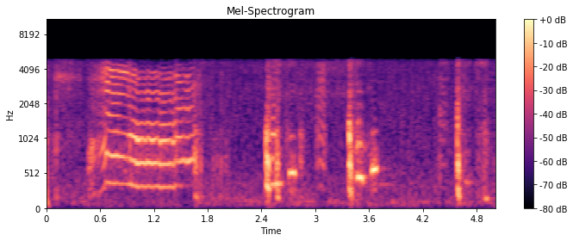
Audio classification: ESC-50 Dataset
The ESC-50 dataset consists of 2 000 labeled environmental recordings equally balanced between 50 classes (40 clips per class). For convenience, they are grouped in 5 loosely defined major categories (10 classes per category):
animal sounds,
natural soundscapes and water sounds
human (non-speech) sounds,
interior/domestic sounds,
exterior/urban noises.
Fig3: Audio preprocessing
Tab1: ESC-50 classes
Fig4: Example of mel-spectogram

Slide 7
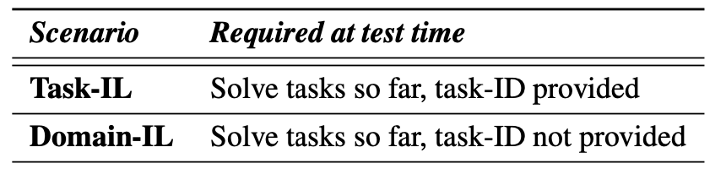
CL scenarios
CL strategies
Multi task incremental: Given a sequence of train and test dataset, it creates the continual stream of data as a series of experiences. Each experience will contain all the instances belonging to a certain set of classes and a class won’t be assigned to more than one experience.
Naive: It just incrementally fine-tunes a single model without employing any method to contrast the catastrophic forgetting of previous knowledge.
EWC (Elastic Weight Consolidation): It computes importance of each weight at the end of training on current experience. During training on each minibatch, the loss is augmented with a penalty which keeps the value of the current weights close to the value they had on previous experiences in proportion to their importance on that experience.
Domain Incremental: Given a sequence of train and test datasets, it creates the continual stream of data as a series of experiences. This generator splits the original training set by creating experiences containing an equal amount of patterns using a random allocation schema.
Replay: the idea is that we do not preserve specific set of examples exactly as they are seen in the past but this approach train generative models on the data distribution. A typical way to implement a generative replay is through dual models.

Slide 8
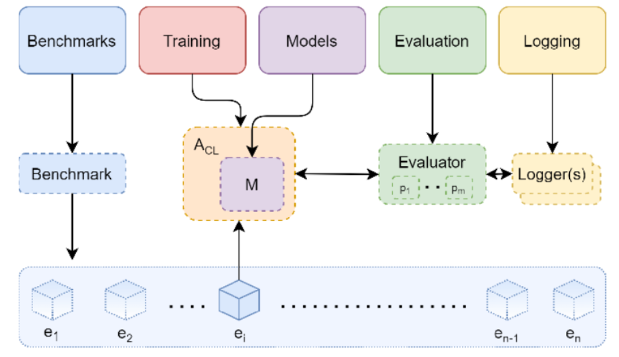

Avalanche: an end-to-end library for Continual Learning
Avalanche is an End-to-End Continual Learning Library based on PyTorch, born within ContinualAI with the unique goal of providing a collaborative and community-driven open-source (MIT licensed) codebase for fast prototyping, training and reproducible evaluation of continual learning algorithms.
Avalanche can help Continual Learning researchers and practitioners in several ways:
Write less code, prototype faster & reduce errors.
Improve reproducibility.
Improve modularity and reusability.
Increase code efficiency, scalability & portability.
Augment impact and usability of your research products.
Fig2: Avalanche components

Slide 9
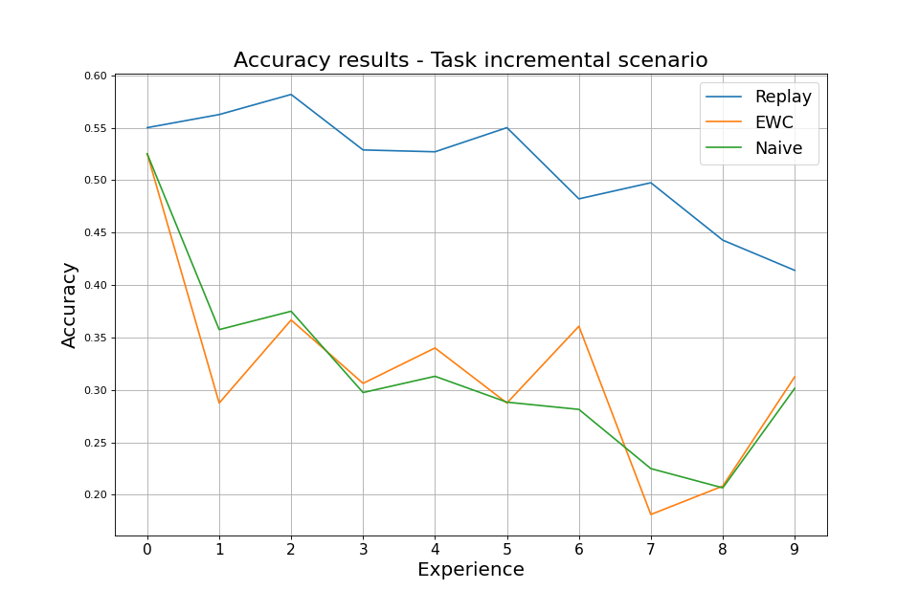
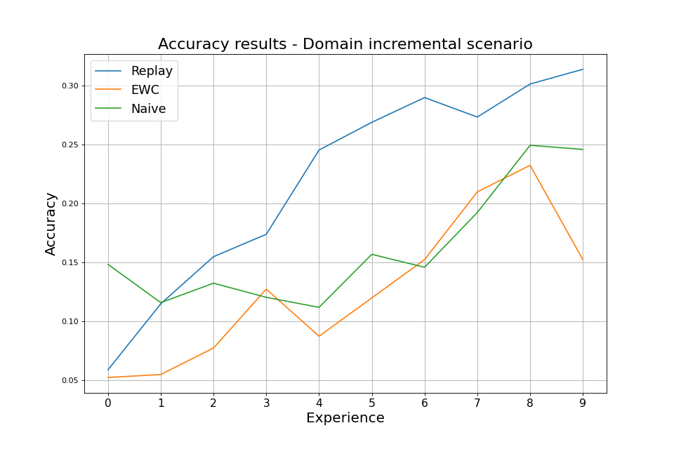
Evalauting CL metrics: Accuracy 1/4
Accuracy: In MIT, it is calculated in each iteration, after every training on different experience and we take in consideration the average of the accuracy calculated on some tasks. In DI this metric is calculated over global data set.

Slide 10
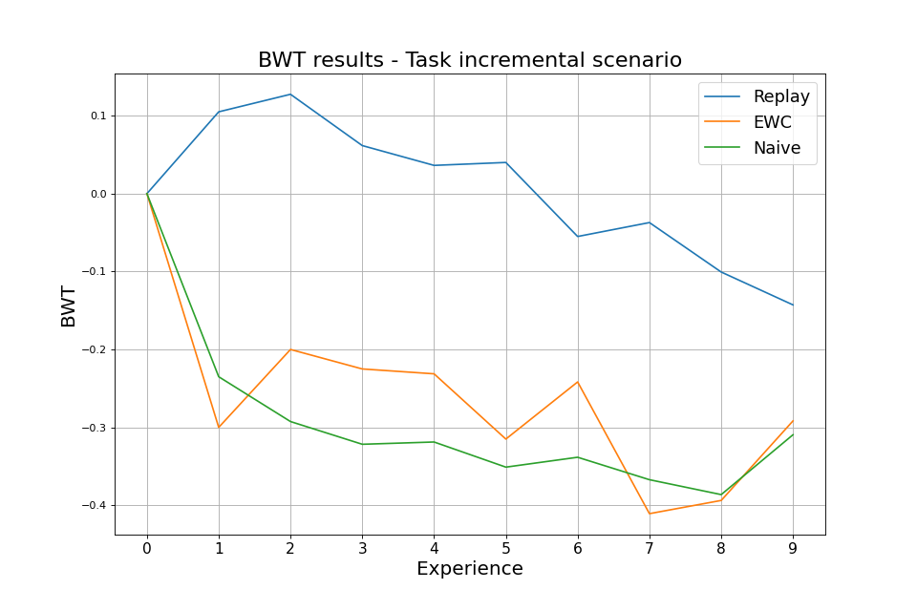
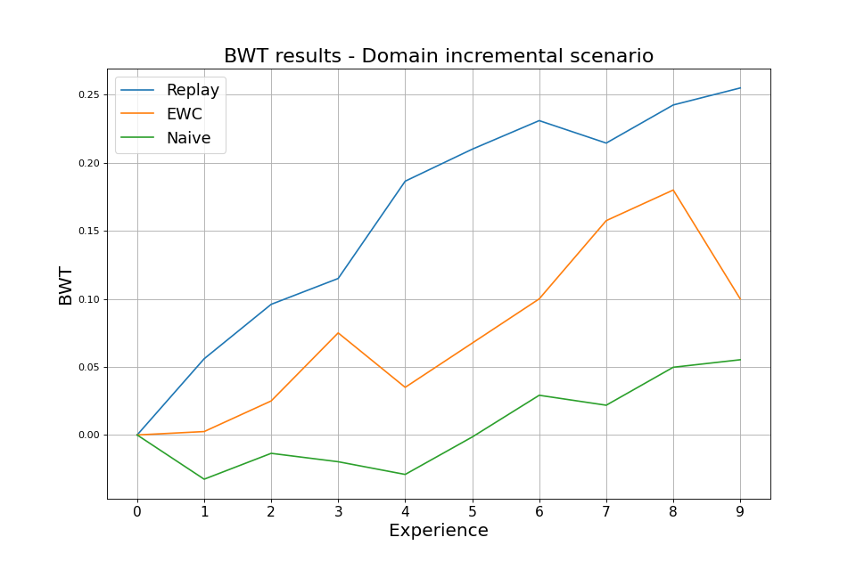
Evalauting CL metrics: Backward Transfer 2/4
BWT (Backward Transfer): it measures the influence that learning a task has on the performance on previous tasks. It is considered as the average of the backward transfer after each task.

Slide 11
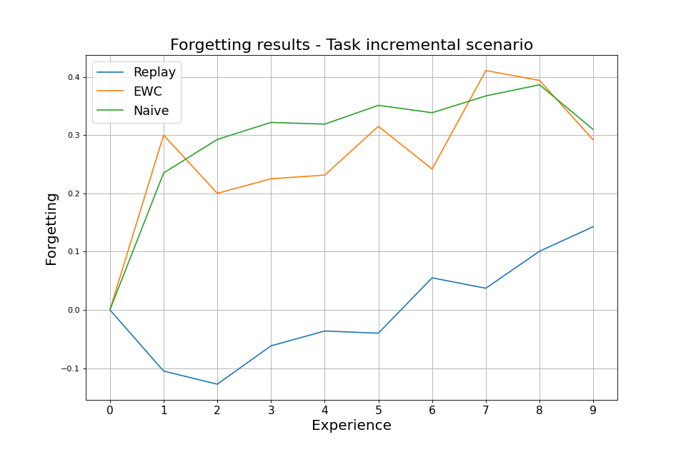
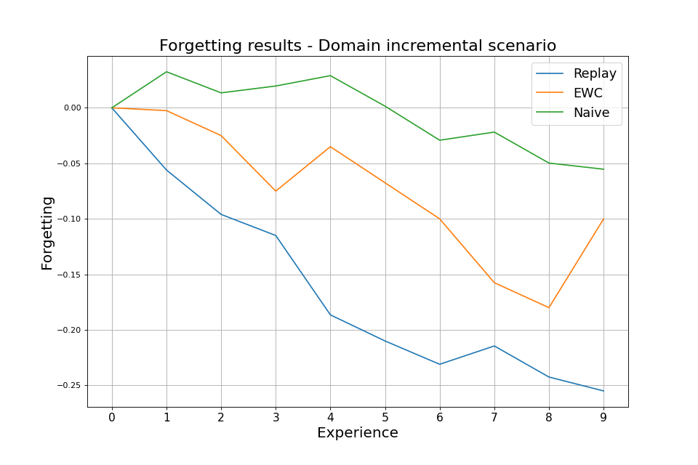
Evalauting CL metrics: Forgetting 3/4
Forgetting: it is calculated from BWT value and when it gets values below zero, it means that our strategy comes across the catastrophic phenomenon. It is considered as the average of the forgetting after each task.

Slide 12
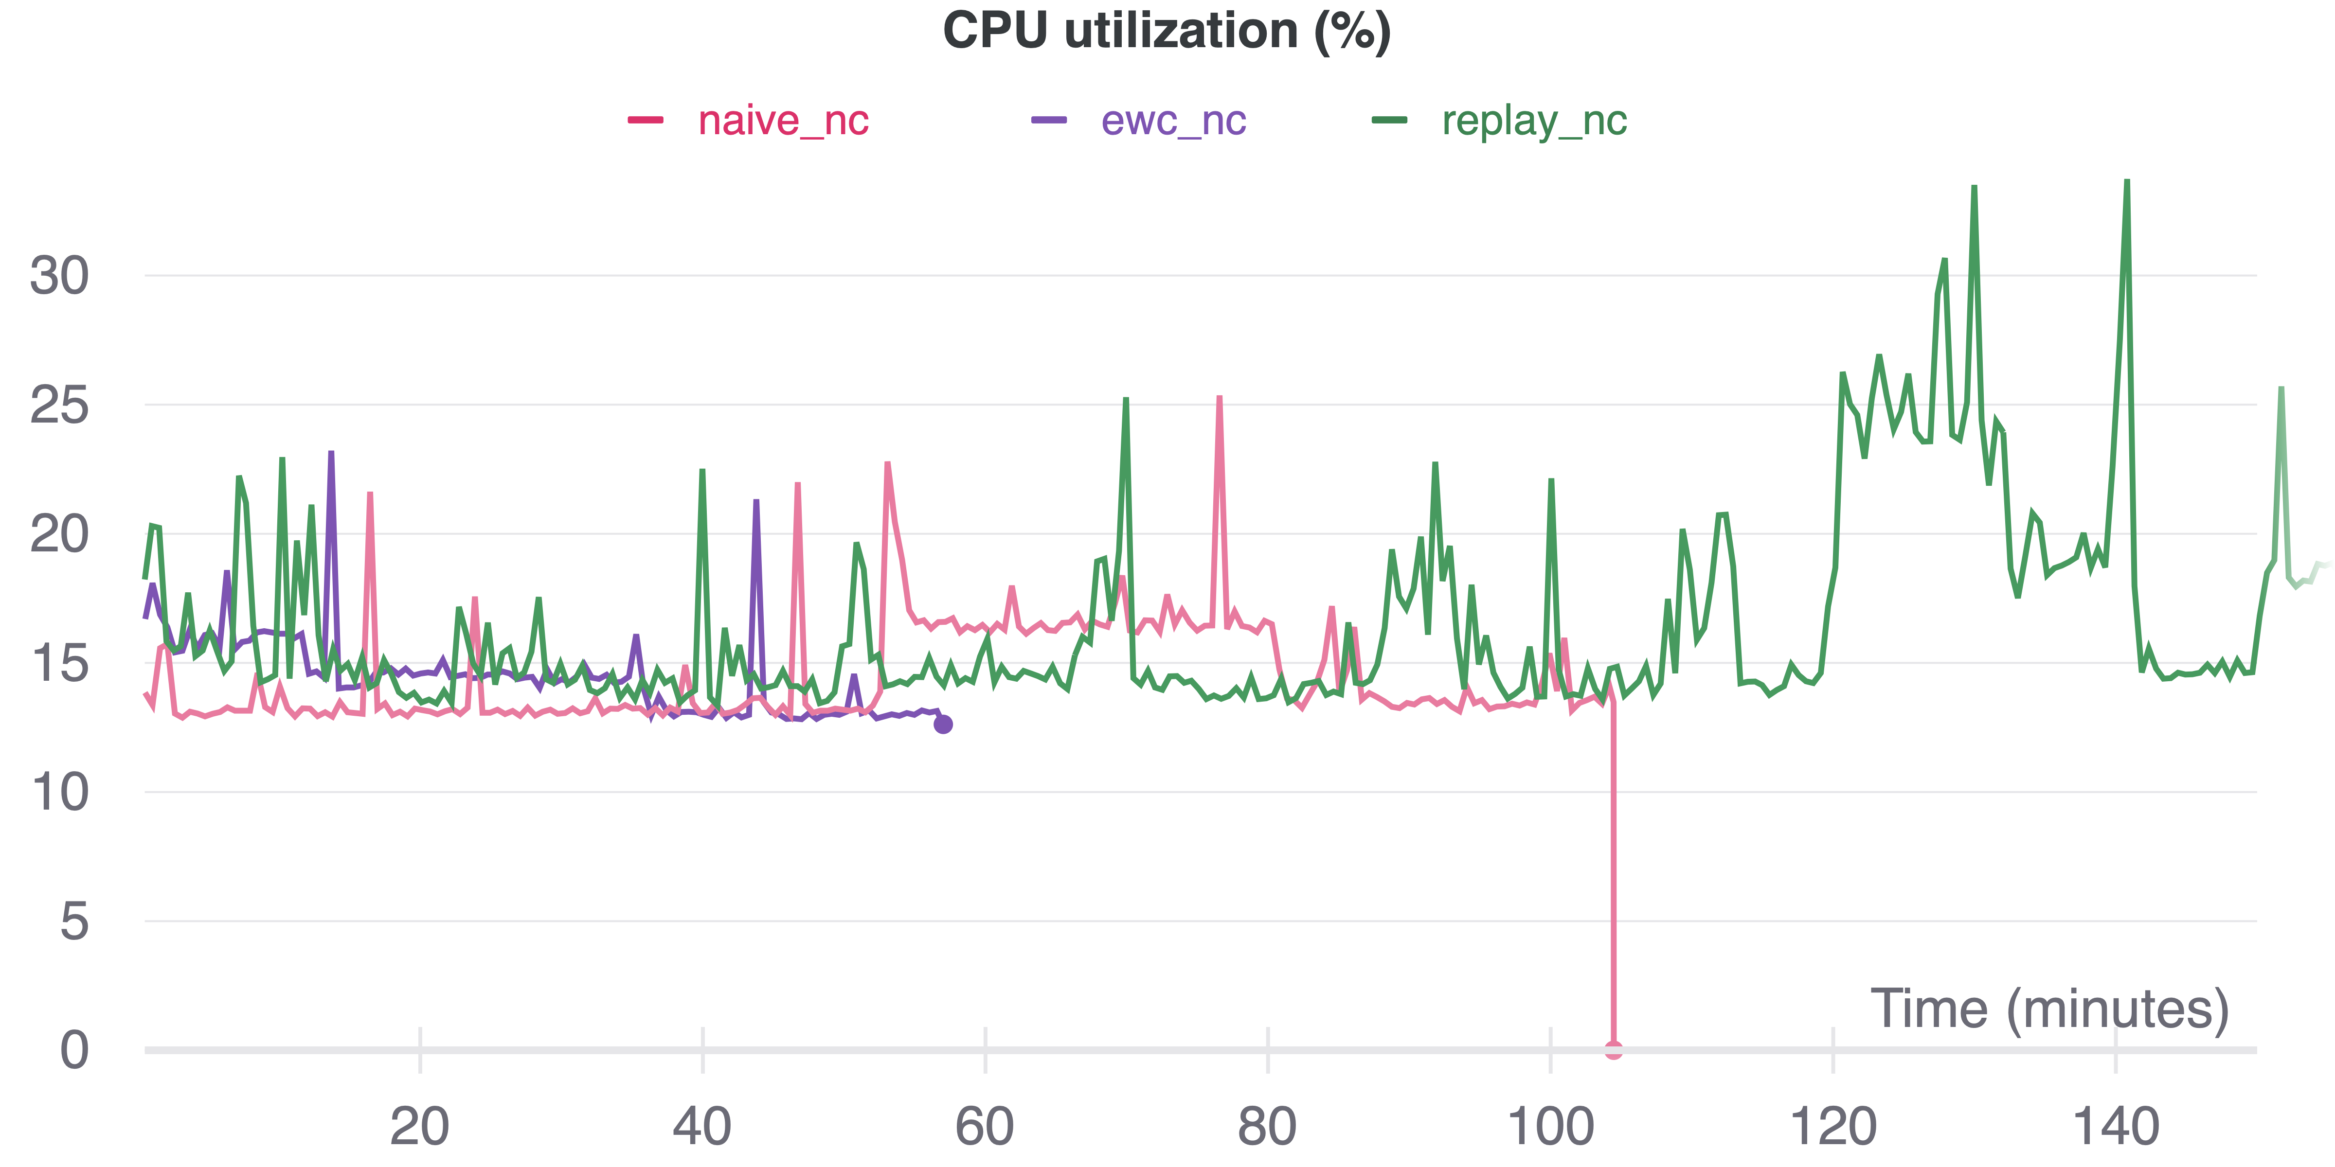
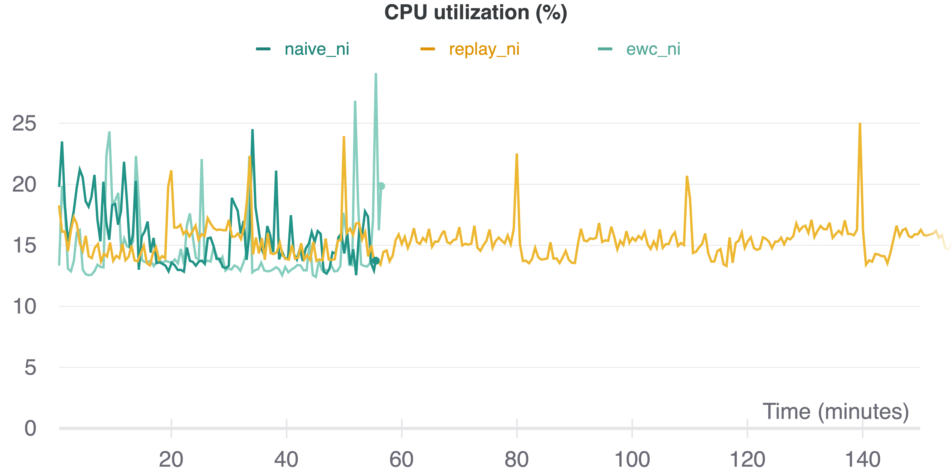
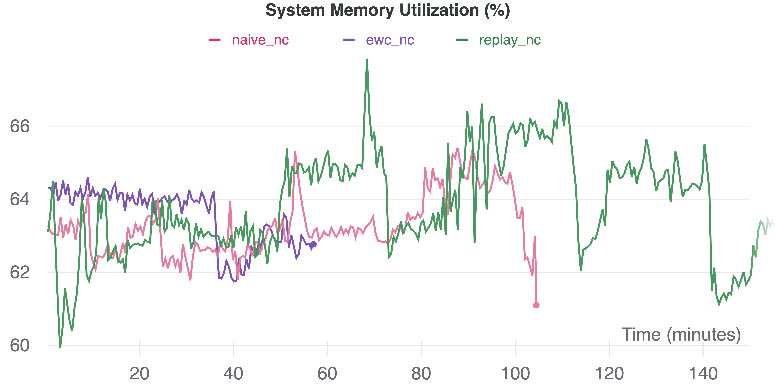
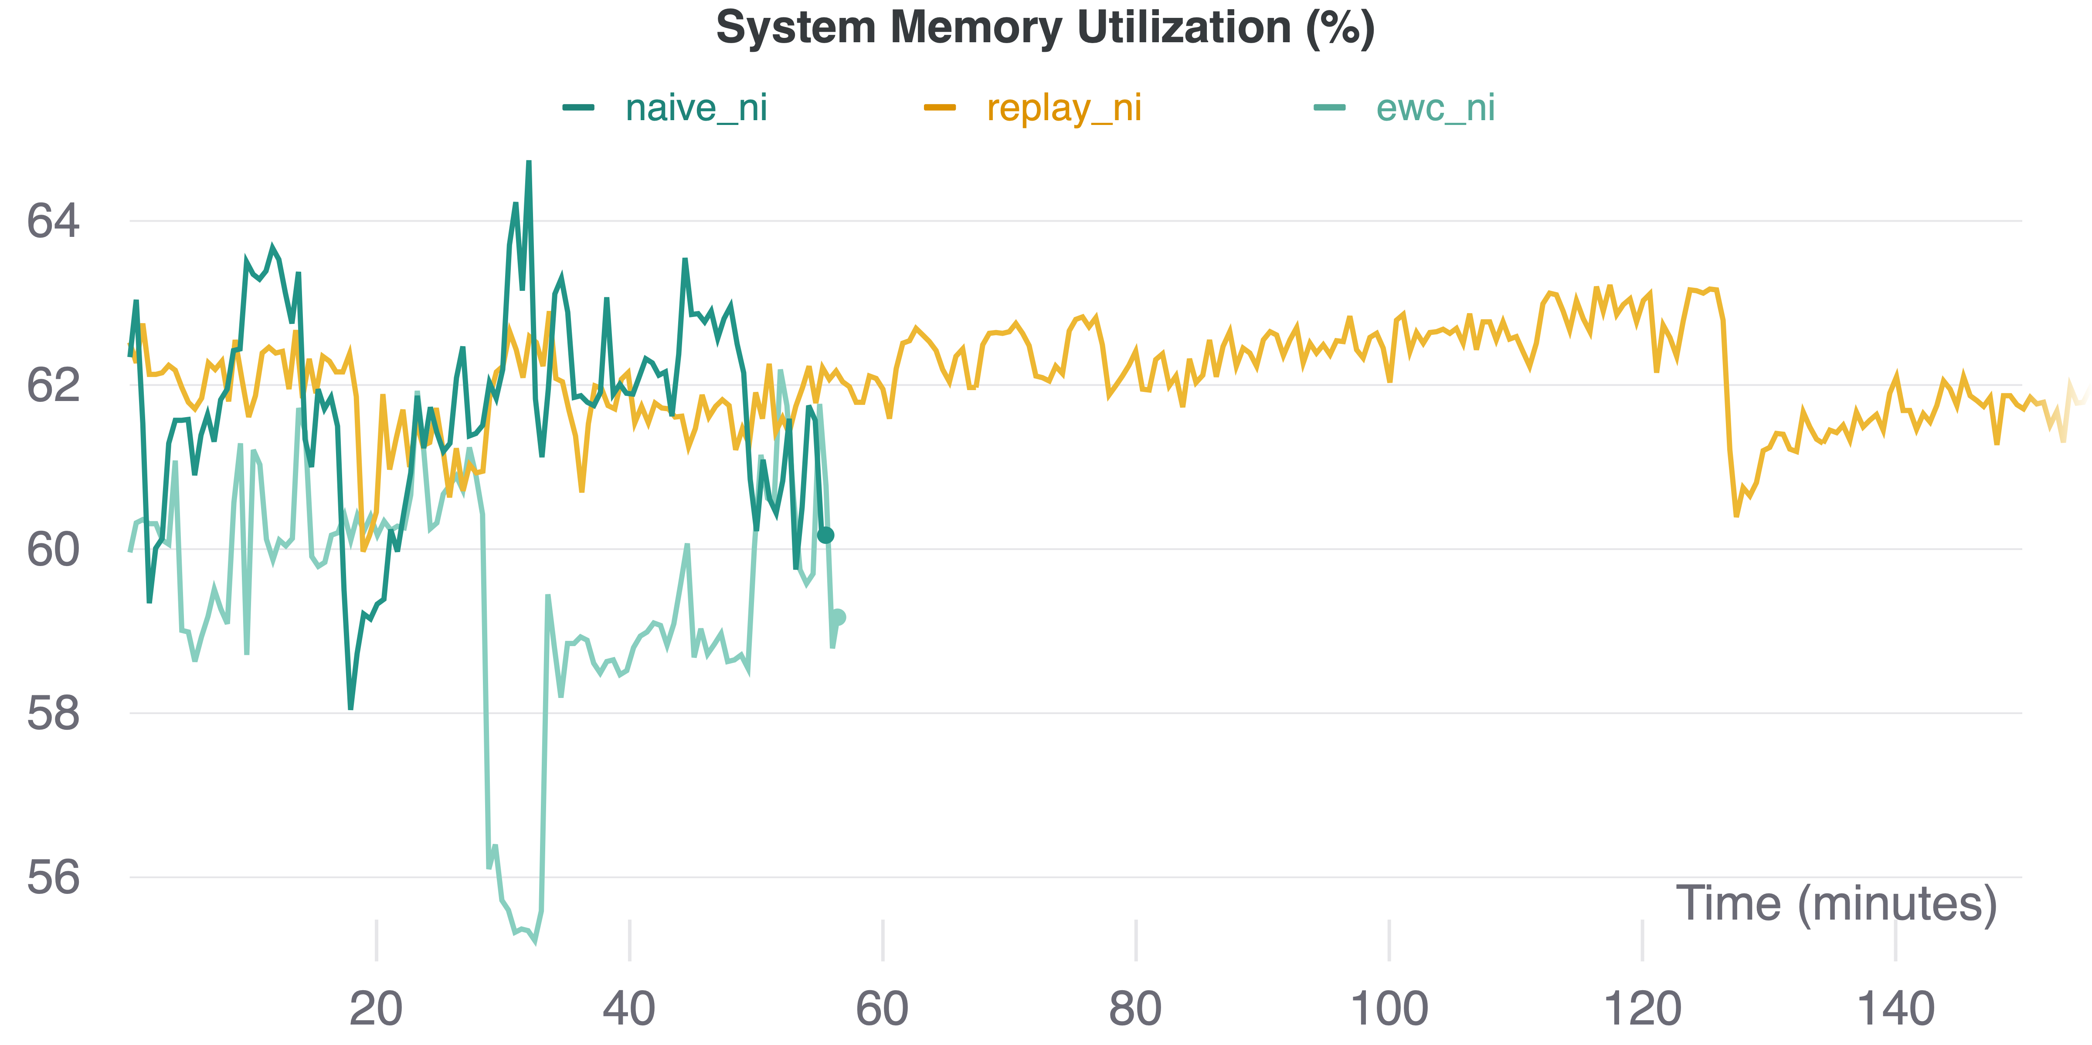
Evalauting CL metrics: System Metrics 4/4
Multi Task Incremental
Domain Incremental

Slide 13
Conclusions and Contributions
From all results obtained by evaluation of Continual Learning strategies, Replay algorithm seems to be the best strategy, even if metric values are not very optimal, while EWC doesn’t work well in the context of Audio Classification. Among two CL scenarios explored, during Domain Incremental, catastrophic forgetting phenomenal is not present; while in MIT it is a bit present but the performance (in terms of accuracy and loss) is better.
Presented results can also be seen as a contribution of Avalanche for unexplored scope, such us audio classification.
We gave a working implementation of two different benchmarks based on Continual Learning scenarios (Multi task incremental and Domain Incremental) on ESC-50 dataset for the Environment Sound Classification.
Future Works:
Evaluation of other Continual Learning strategies over the same benchmarks;
Optimization or creation from scratch of new CL strategies (possibly starting from Replay algorithm)
New contributions in Avalanche library in the context of audio classification, creating more benchmarks on different dataset and introducing possiblly new algorithm in order to test new benchmarks.

Slide 14
QUESTIONS?
( All thesis material - Github Repository )
THANK YOU FOR YOUR ATTENTION!
Alessandro Taglieri, 1890945

